Slide 1
Lending Club Case Study
By –
Ranjit Patra
Kanchan Singh

Slide 2
Problem Statement and Objective
Problem Statement:
Lending Club is a marketplace for loans that matches borrowers who are seeking a loan with investors looking to lend money and make a return.
When Lending Club receives a loan application, the company has to make a decision for loan approval based on the applicant’s profile. Two types of risks are associated with the bank’s decision :
If the applicant is likely to repay the loan, then not approving the loan results in a loss of business to the company.
If the applicant is not likely to repay the loan, then approving the loan may lead to a financial loss for the company
Objective: The Objective of this case study is to use the provided data (loan.csv) to identify driving factors before making decision on loan application. So, the lending club can utilize these factors to make decisions before approving or rejecting an loan.

Slide 3
Data Cleaning
Removed fully empty columns.
Columns which were having more than 70% empty data were removed.
Columns those had one unique entry throughout were dropped.
Filled a few columns empty value with 0 or other available values.
There were no duplicate rows in the data set.
Removed columns which were not required for analysis.
Did not consider loan status with “Current” value.

Slide 4
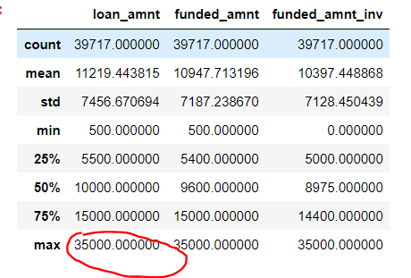
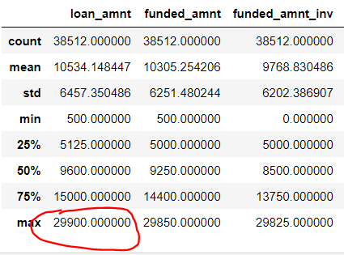
Outliers Treatment:
Loan Amount – See the flowing stats before and after outlier treatment for loan amount.
Before Outlier Treatment | After Outlier Treatment

Slide 5
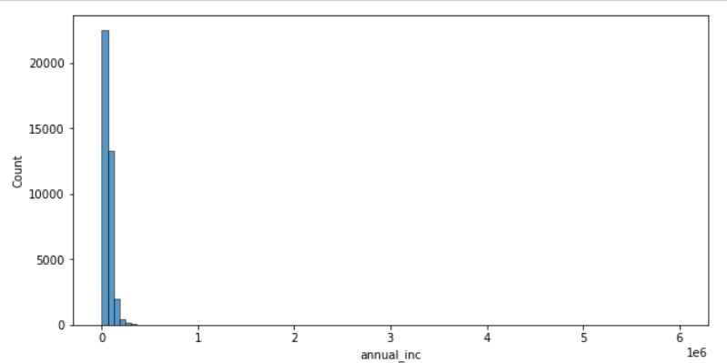
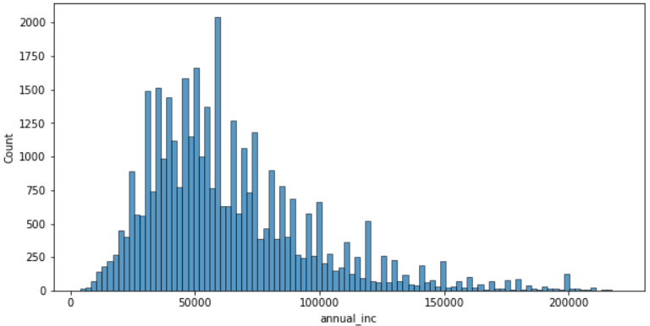
Outliers Treatment:
Annual Income – See the flowing stats before and after outlier treatment for loan amount.
Before Outlier Treatment | After Outlier Treatment

Slide 6
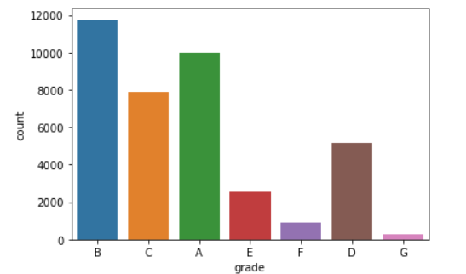
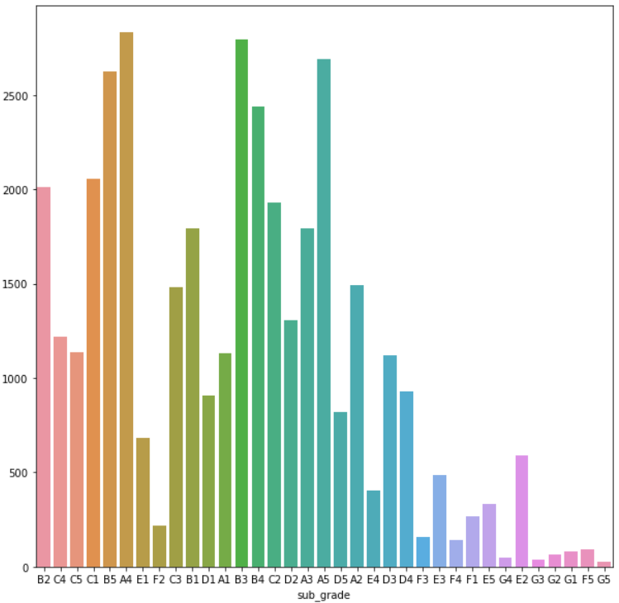
Univariate Analysis
Grade and Sub Grade – We can see that most applicants are from Grade B and Sub Grade A4 and B3.
Before Outlier Treatment | After Outlier Treatment

Slide 7
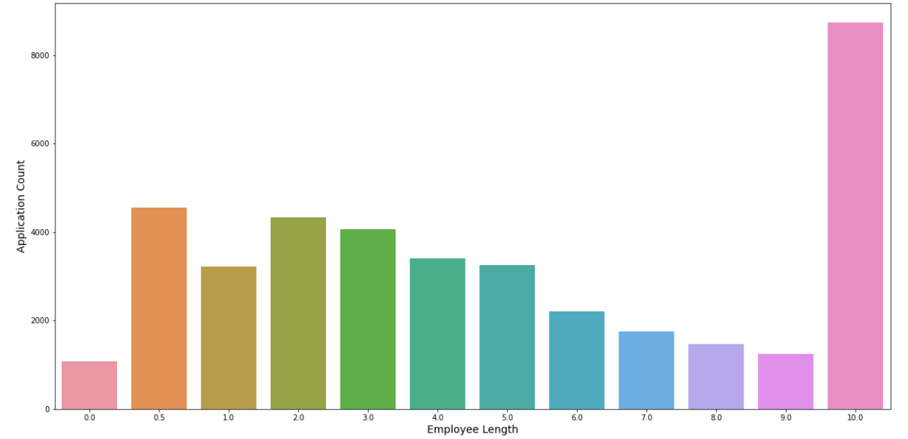
Univariate Analysis
Employment Length – Loan applicants are getting decreased with employment length, until it reaches to 10 and applicants are high with 10+ employment.

Slide 8
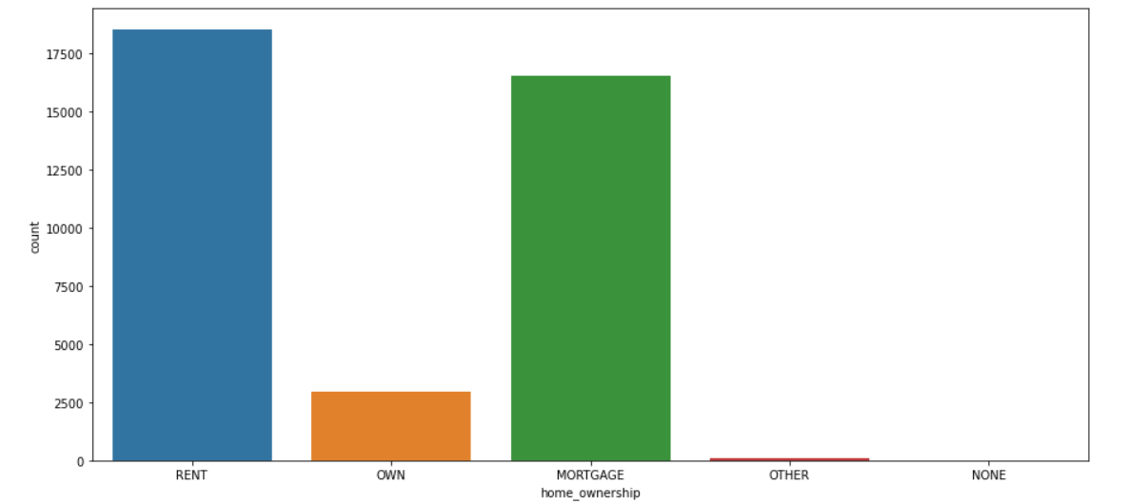
Univariate Analysis
Home Ownership – The majority of the applicants belongs to RENT or MORTGAGE category.

Slide 9
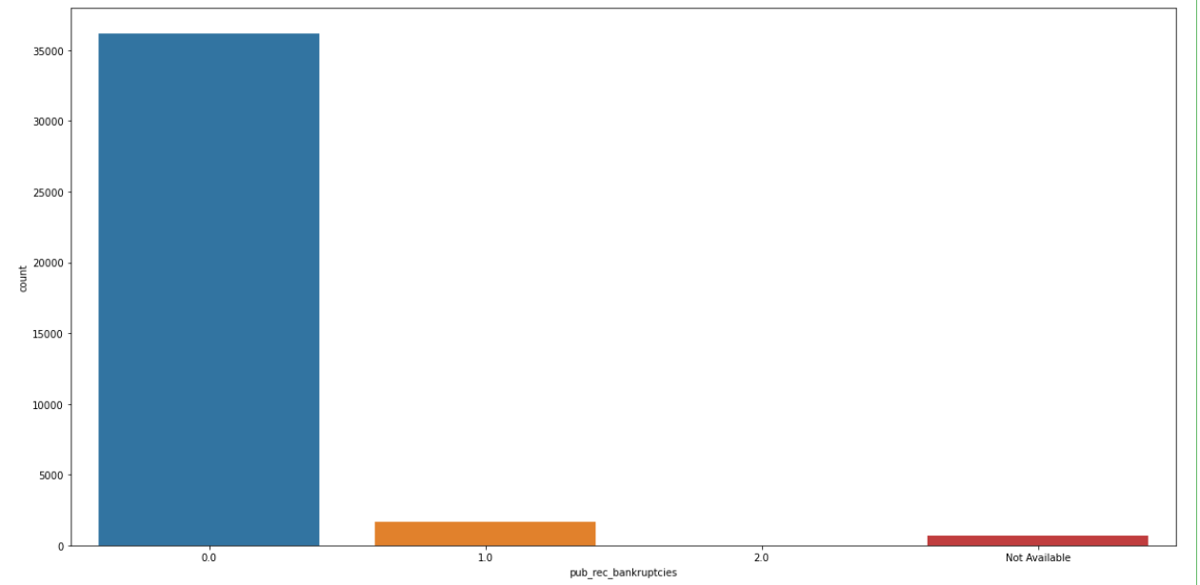
Univariate Analysis
Public Record Bankruptcies – Most of the applicants has 0 public record bankruptcies.

Slide 10
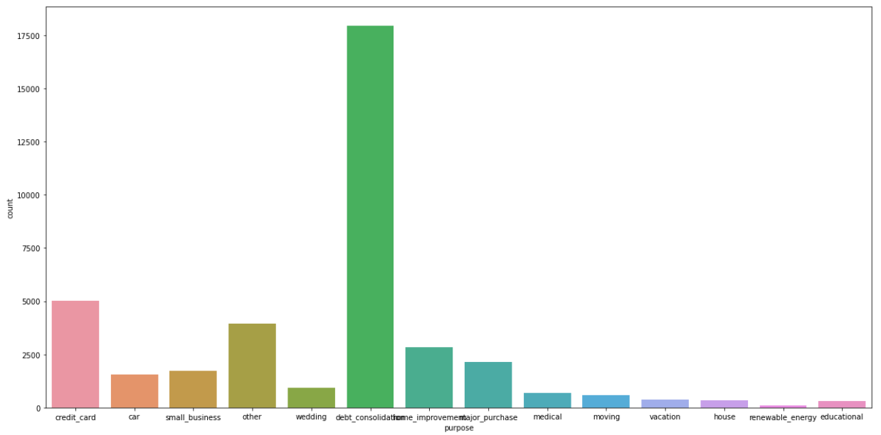
Univariate Analysis
Purpose – Majority of the applicants applied loan with the purpose debt consolidation.

Slide 11
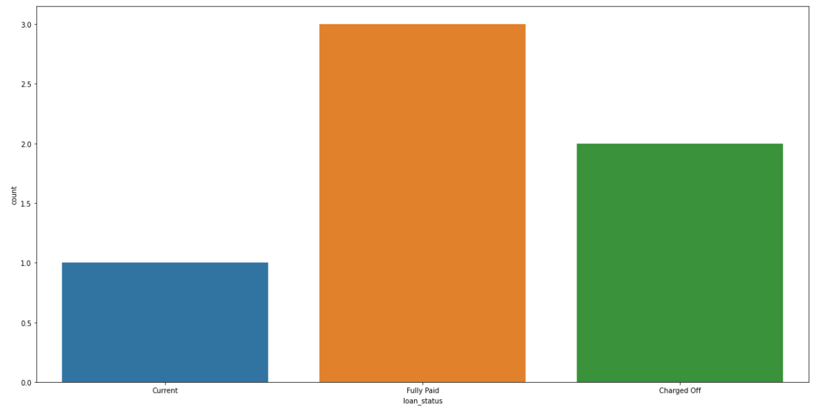
Segmented Univariate Analysis
Loan Status – Charged Off getting increased for more Bankruptcies and it is 22.5% for 1 times bankruptcies and increased to 33% for 2 times bankruptcies.

Slide 12
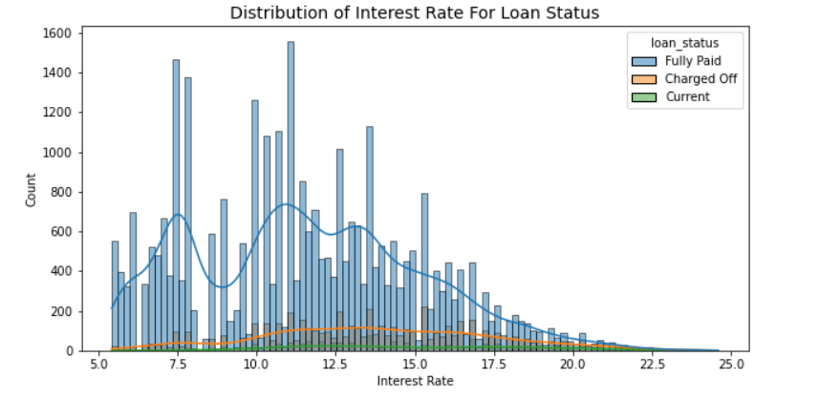
Bivariate Analysis
Interest Rate and Loan Status – Charged Off increases with interest rate and shows are decline aftre 17.5%.

Slide 13
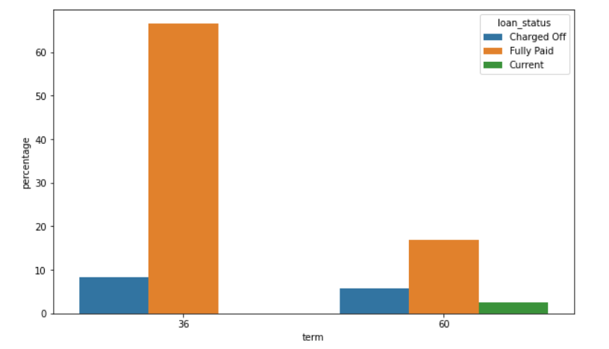
Bivariate Analysis
Term and Loan Status – Longer term has a high charged off percentage.

Slide 14
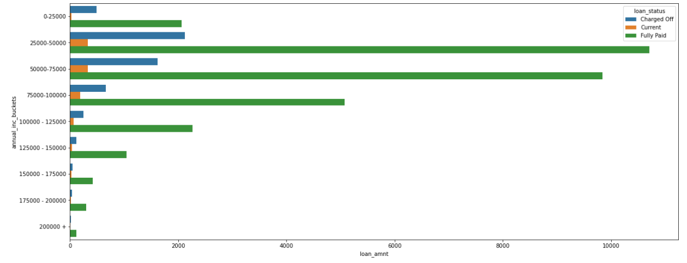
Bivariate Analysis
Annual Income and Loan Amount – Longer term has a high charged off percentage.

Slide 15
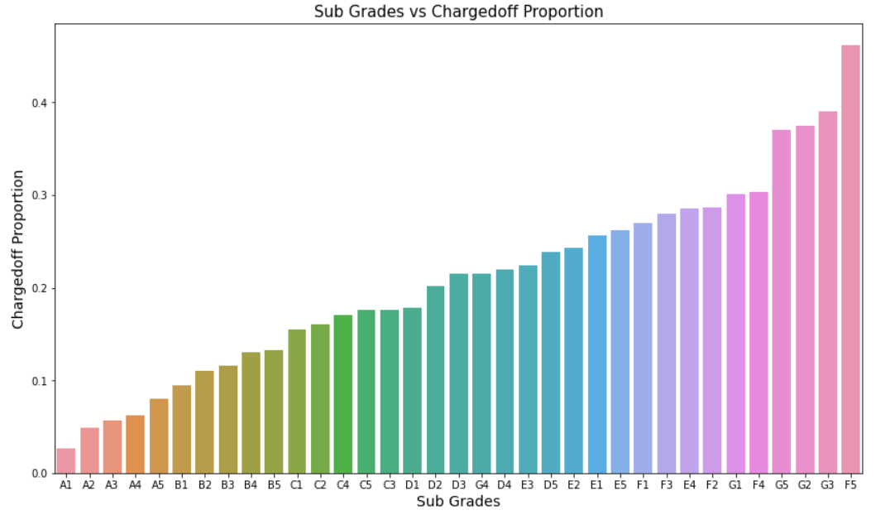
Bivariate Analysis
Sub Grades and Charged off Proportion – Sub Grades of "A" has very less chances of charged off. Sub Grades of "F" and "G" have very high chances of charged off and proportion of charged off is increasing with sub grades moving from sub grades of "A" towards sub grades of "G".

Slide 16
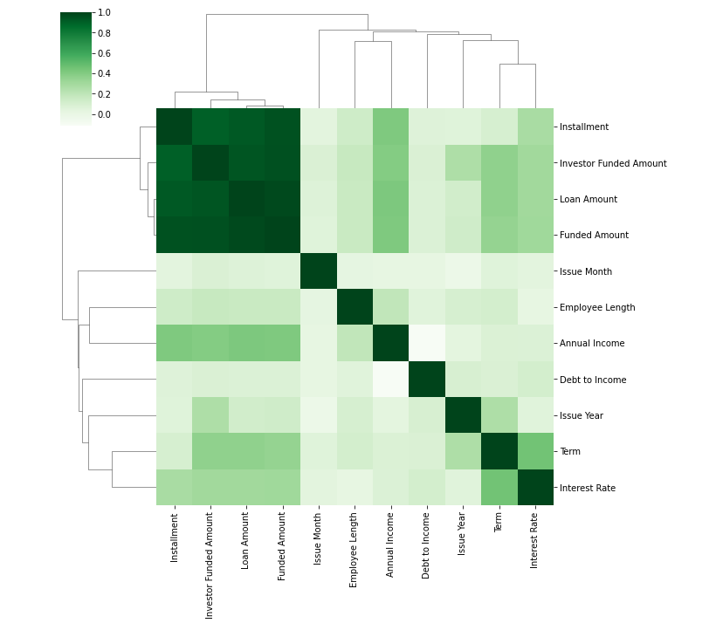
Correlation
Co relation among numerical variables.

Slide 17
Recommendations
Driving Factors
Public record bankruptcies | Applications with bankruptcies records should be rejected.
Term | Applicants with long term has hight percentage of changed off and we should deny those applicants.
Annual income | There is high risk involved with applicants with high annual income.
DTI | Increase in DTI Charged off also getting increased. So, we should wisely consider these applicant.
Interest Rate | High rate are not defensive to become a default, so better strategy could be deny those particular applicants.
Address State | Applications from the state NV, FL, MO has high chance of charged off. Therefore denying loans to risky individuals may be better strategy.
Purpose and Funded Amount (Investor) | Investor approved amount in bucket (20000 - 25000) has high risk involved.

